Slide 3
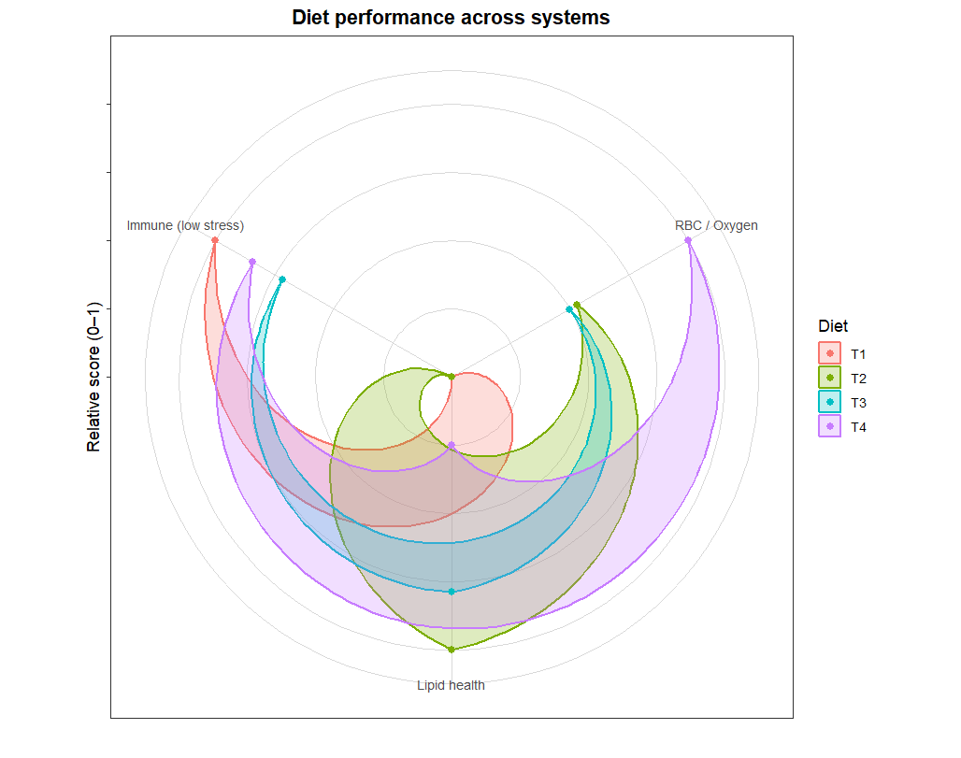
Figure X. Integrated radar plot showing diet-level performance across three physiological systems.
Scores represent standardized means for RBC/oxygen capacity (right axis), lipid health (bottom axis; higher = healthier lipid profile), and immune stress (left axis; higher = lower stress, derived from −scaled NLR). T2 shows the best lipid metabolic profile, extending farthest along the lipid axis. T4 displays the strongest erythrogram response, with the highest RBC/oxygen score. Immune stress shows an unexpected but data-supported pattern: T1 has the highest immune health score, followed by T4 and T3, while T2 shows the highest relative immune stress. Each diet forms a distinct physiological signature across systems, demonstrating diet-specific effects.

Slide 4



